Slide 1
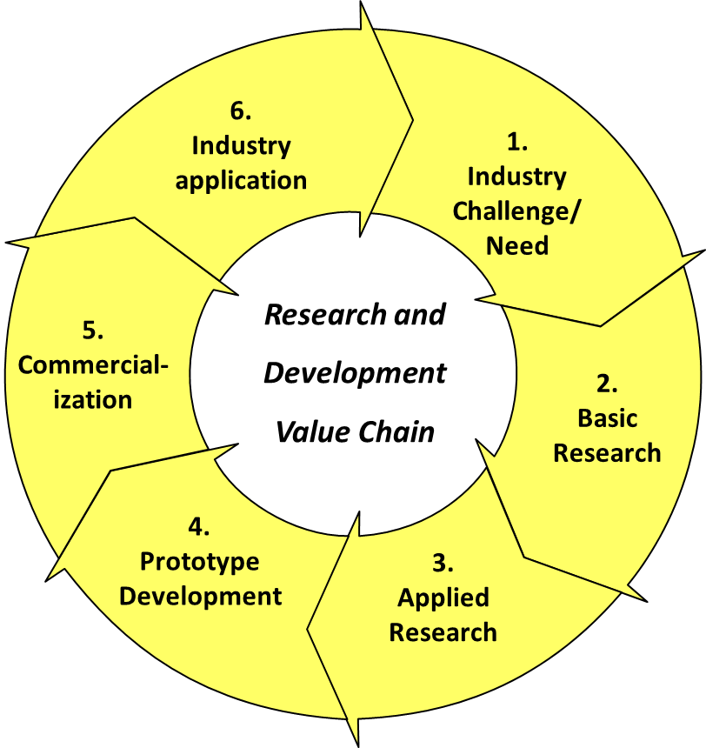
2.0 Research and Development (R&D) Framework
Pursuant to the aforementioned provisions, an R&D framework has been designed to drive R&D implementation as illustrated below
3.0 Policy Thrust for R & D Framework
The R&D framework is anchored on the following broad Policy Thrust:
  Focus on market driven research
  Establish world class Research and Development (R&D) Centers of Excellence
  Establish Research and Development Council
  Provide sustainable funding to support Research and Development
  Develop stakeholder collaboration matrix for Research and Development (R&D)
  Provide enablers for commercialization of research breakthrough
  Facilitate acceptance and utilization of products of research by end users

